Slide 1

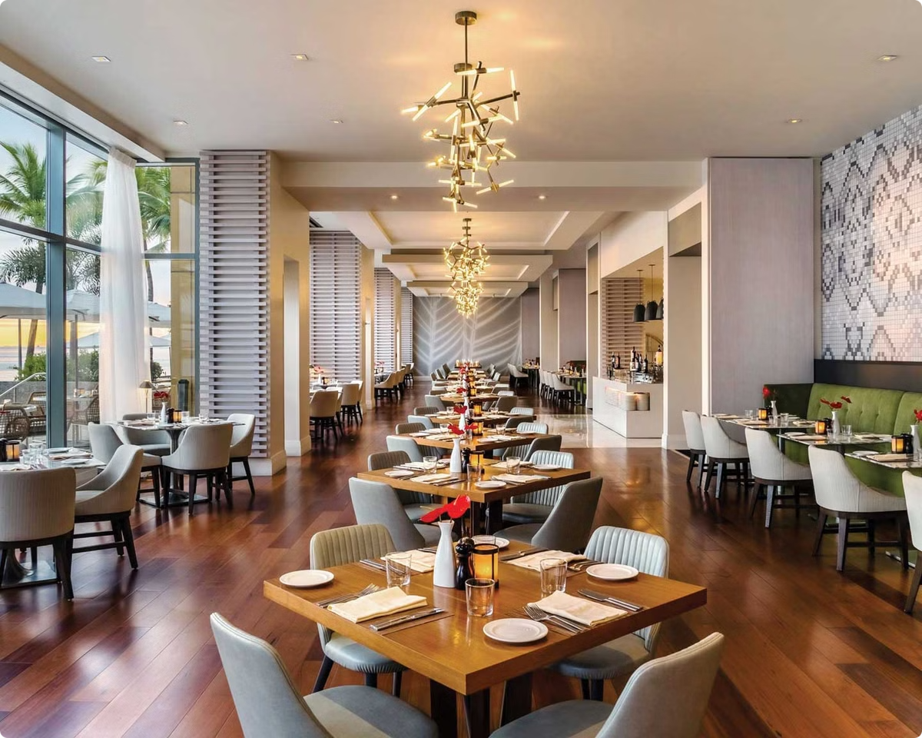
Restaurant Recommendation System
Discovering the perfect restaurant can be a daunting task, but with the power of data and personalized recommendations, the process becomes streamlined and tailored to individual preferences.

Slide 2

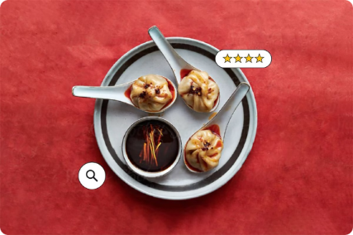
The Problem: Finding the Right Restaurant
1
Overwhelming Options
2
Varying Preferences
3
Outdated Recommendations
With countless dining establishments in most cities, it can be challenging to sift through and find the ideal restaurant.
Each person has unique tastes and requirements when it comes to cuisine, ambiance, and dining experiences.
Traditional word-of-mouth recommendations may not keep up with the dynamic nature of the restaurant industry.

Slide 3
Leveraging Data to Solve the Problem
Collecting User Data
Analyzing Restaurant Data
Integrating the Data
Gathering information on customer preferences, past dining experiences, and feedback to build a comprehensive user profile.
Compiling data on menu items, pricing, reviews, and other relevant attributes to create a detailed restaurant database.
Combining user and restaurant data to identify patterns, trends, and personalized recommendations.

Slide 4

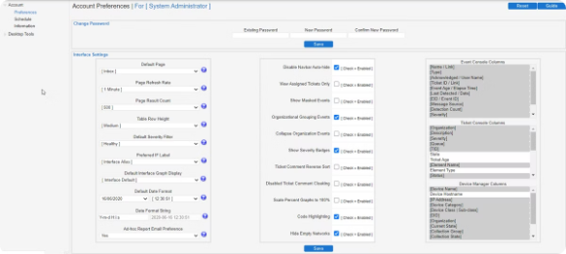
Gathering and Analyzing User Preferences
Explicit Feedback
1
Collecting user ratings, reviews, and preferences directly through surveys and interactions.
2
Implicit Behavior
Observing user behavior, such as search history, location data, and past dining choices.
Demographic Information
3
Incorporating user demographic data, such as age, gender, and dietary restrictions, to personalize recommendations.

Slide 5

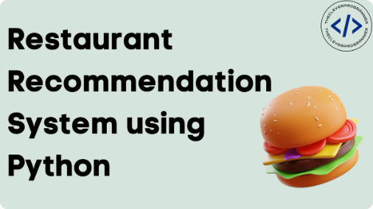
Applying Machine Learning Algorithms
Collaborative Filtering
Content-Based Filtering
Hybrid Approaches
Identifying patterns in user preferences and recommending restaurants based on similar users' preferences.
Analyzing restaurant attributes, such as cuisine, price range, and ambiance, to recommend options that match user preferences.
Combining collaborative and content-based filtering to leverage the strengths of both methods for more accurate recommendations.

Slide 6




Personalizing Restaurant Recommendations
Location-Based
Cuisine Preferences
Considering user's current location and proximity to restaurants for convenience.
Recommending restaurants that align with the user's favorite cuisines and dietary needs.
Price Range
Ambiance Preferences
Suggesting restaurants within the user's preferred budget for a dining experience.
Matching restaurant ambiance, such as casual, formal, or romantic, to the user's desired dining atmosphere.

Slide 7


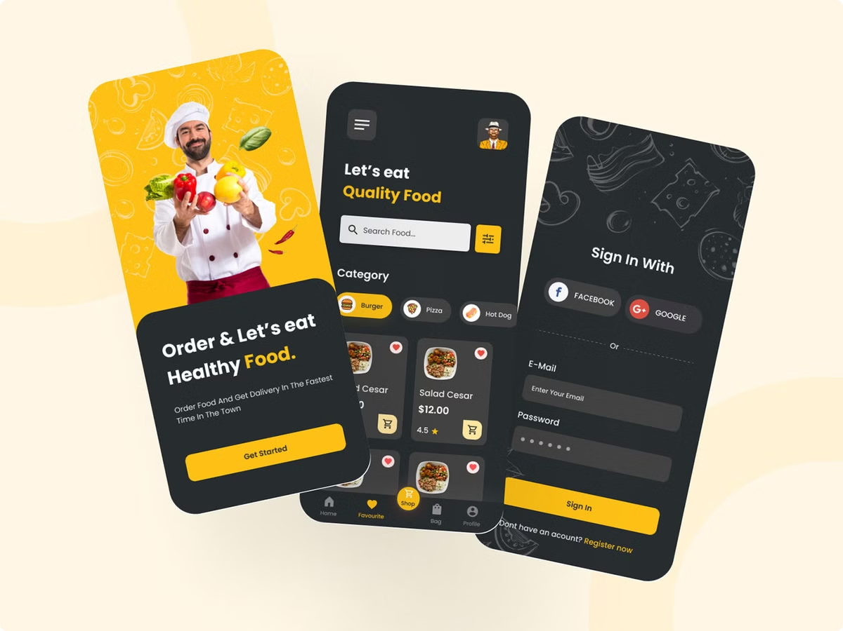


Integrating with Mobile Apps and Platforms
User-Friendly Interface
Designing intuitive and visually appealing mobile experiences for seamless restaurant discovery.
Real-Time Updates
Providing users with the latest information on restaurant availability, menu changes, and user reviews.
Reservation Capabilities
Enabling users to easily book tables and manage their dining reservations within the app.

Slide 8

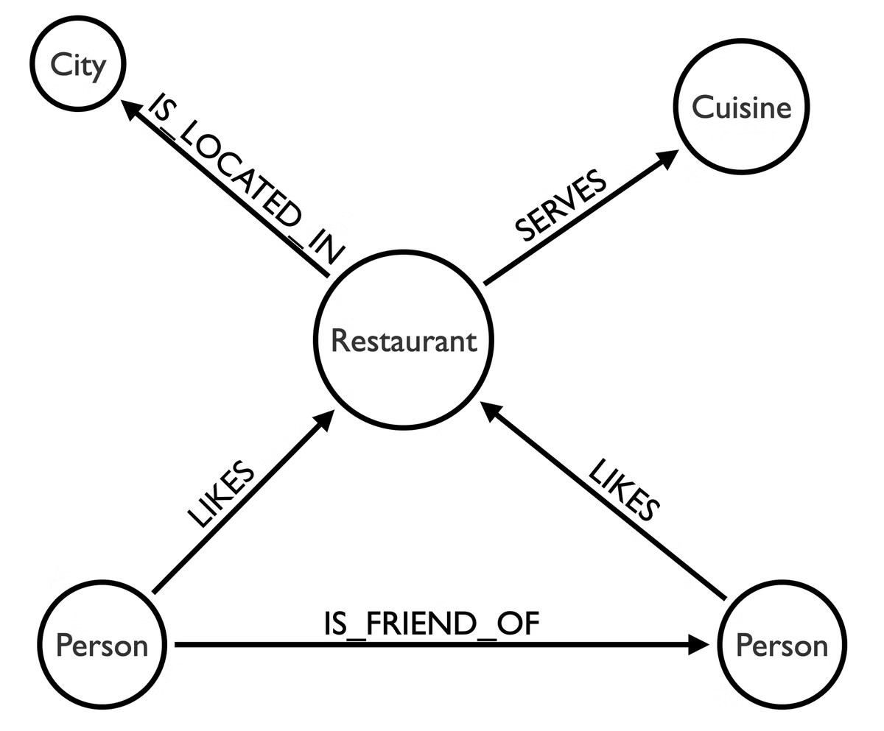
Measuring Success and Iterating
User Engagement
Tracking app usage, search queries, and user interactions to identify areas for improvement.
Recommendation Accuracy
Monitoring user feedback and satisfaction rates to fine-tune the recommendation algorithms.
Business Impact
Analyzing the impact on restaurant bookings, revenue, and customer retention to measure the system's effectiveness.

